Slide 1
CSE 2102: Introduction to Software Engineering
Software: Its Nature and Qualities

Slide 2
Introduction
Software engineering (SE):
  Intellectual activity, human-intensive
Software product:
  Delivers certain functions
  Must meet certain qualities
Software development processes:
  Also must meet certain qualities
Software qualities are sometimes referred to as “ilities”

Slide 3
Software product vs. traditional products

Slide 4
What are software qualities?
Characteristic to be attained throughout a system’s lifetime
  Both product and process
Software qualities:
  Correctness and reliability
  Robustness and performance
  User friendliness and verifiability
  Maintenance and reusability
  Repairability and evolvability
  Portability, understandability, and interoperability
  Productivity, timeliness, and visibility
Software quality assurance: assess and evaluate the attainment of qualities by finished product

Slide 5
Classification of software qualities

Slide 6
Correctness
Functional correctness: Software behaves according to requirements specifications
If specifications are formal, since programs are formal objects, correctness can be defined formally
  Proven as a theorem or disproved by counterexamples (testing)
Assessing correctness - potential problems
  Assumes requirements specifications are available, up-to-date and correct
  Assumes correctness testing is possible
  Assumes mathematical properties can be established between software and specifications
Correctness is an absolute (yes/no) quality
  No concept of “degree of correctness”
  No concept of severity of deviation

Slide 7
Correctness (contd..)
Example: Cars
  Compute acceleration/decceleration correctly when brakes are applied/released.
  In this case, correctness can be verified because there is a mathematical equation that expresses acceleration & decceleration for a given speed and level of braking.
Is it possible to define correctness for all the types of systems?

Slide 8
Reliability
Informally, user can rely on it
Defined mathematically as “probability of absence of failures for a certain time period”
If specifications are correct, all correct software is reliable, but not vice-versa (in practice, however, specs can be incorrect …)

Slide 9
Correctness vs. Reliability

Slide 10
Reliability (contd..)
Cars:
  If the stereo system does not function, the car is still reliable.
  If the transmission dies, the car is unreliable.
  If the oil leaks, and the oil lamp indicator does not turn on, is the car reliable?

Slide 11
Robustness
Software behaves “reasonably” even in unforeseen circumstances (e.g., incorrect input, hardware failure)
Different robustness requirements per domain
  Computer game
  ATM machine
Incorrect behaviors acceptable, as long as a consistent, workable outcome occurs

Slide 12
Robustness (contd..)
Windows 98:
  Plug and play feature would allow you to connect any monitor, printer, keyboard to the computer.
  However, if the printer crashed, disconnected or turned off the OS crashed!
  Unexpected event for the OS.
Cars:
  Timing belts break, or brakes fail – the car should stop.
  Muffler breaks – the car can continue to function

Slide 13
Performance
Efficient use of resources
  Memory, processing capacity, communication
Can be verified
  Complexity analysis
  Performance evaluation (measurement, modeling, simulation)
Performance can affect scalability
  A solution that works on a small local network may not work on a large intranet
Performance is equated with efficiency, scalability, reliability, user-acceptance, etc.
Impact from specification to delivery

Slide 14
Performance (contd..)
Measurement: Measure actual performance of working systems
Analytical models: Build a model and analyze
  General understanding of system
  Queuing models during specification/design
  Redo queuing models after implementation by providing hard numbers to fine-tune
Simulation models: Model simulates actual system
  Predict exact performance of components
  Expensive and time consuming to build
  Yields an accurate estimate
System performance must be addressed from day one throughout lifetime

Slide 15
Performance (example)
Cars:
  Sufficient power to climb uphill.
  Accelerate to a given speed in a reasonable amount of time.
  Efficient in the consumption of gasoline.

Slide 16
Usability
Expected users find the system easy to use
Other term: user-friendliness
Rather subjective, difficult to evaluate
Affected mostly by user interface
  For example: visual vs. textual
Cars:
  The controls for A/C, heater etc. should be more readily accessible than the controls to fine tune the stereo system.
Notes:
.

Slide 17
Security
Ability of the system to protect information (data) and resources:
Availability:
  Information must be available when it is needed
Confidentiality:
  Prevent disclosure of information to unauthorized individuals or systems
Integrity:
  Data cannot be modified undetectably

Slide 18
Verifiability
How easy it is to verify properties
  Mostly an internal quality
  Can be external as well (e.g., security critical application)
Cars:
  How easy it is to verify that the car can stop within a certain distance?
  How easy it is to verify that the car meets emission standards?

Slide 19
Maintainability
Maintenance: Modifications made to the product after release
Maintainability: Ease of maintenance
Maintenance costs exceed 60% of total cost of software
Three main categories of maintenance
  Corrective: removing residual errors (20%)
  Adaptive: adjusting to environmental changes (20%)
  Perfective: quality improvements (>50%)
Modification to legacy software for major improvement or software evolution
Maintanability decomposed as:
  Repairability
  Evolvability

Slide 20
Repairability
Ability to correct problems with limited amount of work and minimal impact
A well designed, modular product is easier to modify than a monolithic project
What is the difference between repairing a software product as opposed to repairing a car, air-conditioner?
Cars:
  Repairing a car may be as simple as replacing a worn out part.
  Usually does not require changes to the design.

Slide 21
Evolvability
Field of dreams: If you build it, it will change!
Key evolvability issues:
  Ease of modifications – add new features, fix and improve the existing features.
  Function of system size
  Modularization vs. monolithic
Over time, evolvability reduces as more and more modifications are made to the product
Cars:
  Add new features, such as replace manually operated windows by power windows.

Slide 22
Reusability
Existing product (or components) used (with minor modifications) to build another product
  Similar to evolvability
Also applies to process
Strive for domain and organization specific reuse
Products most likely to be developed in future
Focused on software components:
  Scientific math and string libraries
  Windowing and GUI building blocks
  Java APIs for enterprise applications, embedded applications.

Slide 23
Reusability (contd..)
Reusability evolving to larger components (for example, Java Beans and subsystems)
Cars:
  Reuse standard parts, for example, brake pads in other models manufactured by the same company.
Reuse of standard parts measure of maturity of the field

Slide 24
Portability
Software can run on different hardware platforms and software environments
  Relevant in new platforms and environments
Important when downloaded in a heterogeneous network environment
Hard in practice – All C++’s not created equal:
  Borland C++ vs. Visual C++ vs. Sun C++
  16 vs. 32 vs. 64 bit architecture
  Core features of the language may be the same
  Compiler/product specific libraries
Newer languages such as Java stress the ability to port without rewriting any code.

Slide 25
Understandability
Internal understandability
  Is the software easy to learn and understand?
  Program understanding is essential to program modification
  Varies based on application domain.
  OS vs. tool vs. small application
  Strongly related to evolvability/verifiability
External understandability:
  From the perspective of the user
  Is the software easy to understand and use?
  Emerging applications/games for children starting at 6 months and up.

Slide 26
Interoperability
Ability of a system to cooperate and coexist with other systems
  For example, a word processor and a spreadsheet
New products must coexist and cooperate with legacy, COTS, databases etc.
Cars:
  Should be able to interoperate with standard gas nozzles, tires etc.

Slide 27
Typical process qualities
Productivity
Timeliness
Visibility

Slide 28
Productivity
A measure of the efficiency of the software production process
Measurable for an individual or a team.
Many metrics used, the most common one is number of classes/lines of code.
  Lines of code is an inadequate metric to measure productivity, why?
Impacted by the problem domain and its complexity
What could be another metric to measure productivity?

Slide 29
Timeliness
Meeting deadlines and market demands
Requires careful scheduling, accurate estimation, and clear milestones
Impacted by changing user requirements:
  Often the development process does not follow the evolution of changing user requirements
  A mismatch occurs between user requirements and the status of the product
Impacted by skills (or lack of skills) of software engineers
Incremental delivery
  Product released in stages
  Complete and incremental requirements

Slide 30
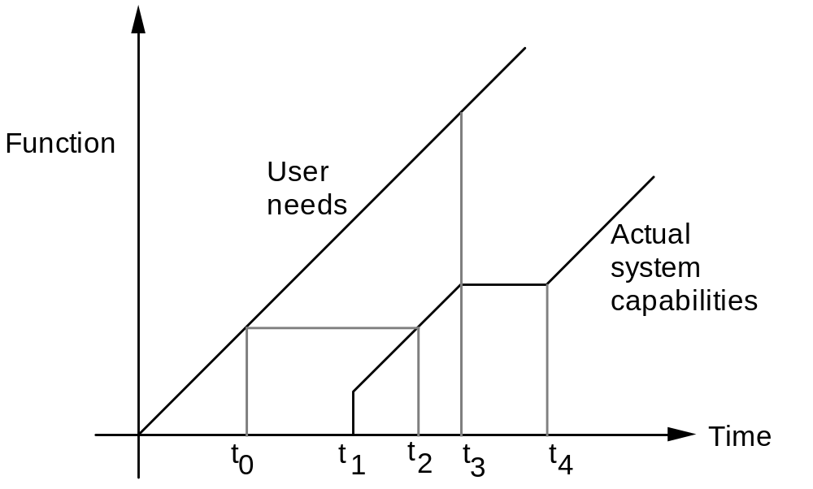
Timeliness (contd..)
A visual description of the mismatch between user requirements
and product status

Slide 31
Timeliness (contd..)
Windows 2000 released in 2002!
Users did not upgrade for 18 months.
Microsoft lost revenue, but currently is unconcerned because there is no competitor!

Slide 32
Visibility
Software process is an open, transparent activity that is shared by developers/managers
  All the steps in the process are well documented
Software engineers are apprised of decisions and choices
Strong visibility results in:
  Team members working in the same direction
  Management and users understand the problem
  Easier integration of new personnel

Slide 33
Quality requirements of information systems
Manage and process information
Database and transaction processing model
Typically characterized by:
  Data integrity: Reliability
  Data security: Correctness
  Data availability: Correctness/Performance
  Transaction processing: Performance
Employs client/server paradigm:
  Client: GUI for User: Non-technical
  Server: Database Management System
  Transactions and results across the network
Emerging fields: Data mining, data warehousing

Slide 34
Quality requirements of real-time systems
Ability of a system to respond to events within a predefined time
Often control oriented
System actions managed to meet priorities
Evaluated by software quality assurance:
  Are requirements attained?
  Performance, correctness and reliability
Safety: The absence of undesirable behavior
User friendliness critical from system operator’s perspective.

Slide 35
Quality requirements of distributed systems
Independent components interconnected by a network for communication
Computing paradigm for today and tomorrow
  Web-based applications
  Client/server paradigm
Characterized by:
  Degree of distribution
  Partitioning of system or information
  Fault tolerance across application
Keys: Correctness, performance, reliability

Slide 36
Quality requirements of embedded systems
Another growing field in computing
Pervasiveness of computers in
  Consumer electronic products
  Appliances and automobiles
Keys: Correctness, Performance and Reliability
Embedded computing and Java:
  PersonalJava: Java in Game Consoles, Smart Phones, Remote Controls, Touch Screens, etc.
  EmbeddedJava: Java in mobile phones, process control applications, network routers, etc.
  Java Card: Smart card technology – credit card computer for personal, health data, etc.

Slide 37

Importance of software product qualities

